Slide 1




Case Study
in Diagnostic and Predictive Analysis.
Dhakal Sandesh - NF1007629
Professor - Ahmed Eltahawi

Slide 2



INTRODUCTION
Objective: Conduct descriptive analysis of patient health data.
Dataset includes demographics, conditions, admissions, billing, insurance, and test results.
Goal: Identify trends, outcomes, and financial insights for better healthcare decision-making.

Slide 3
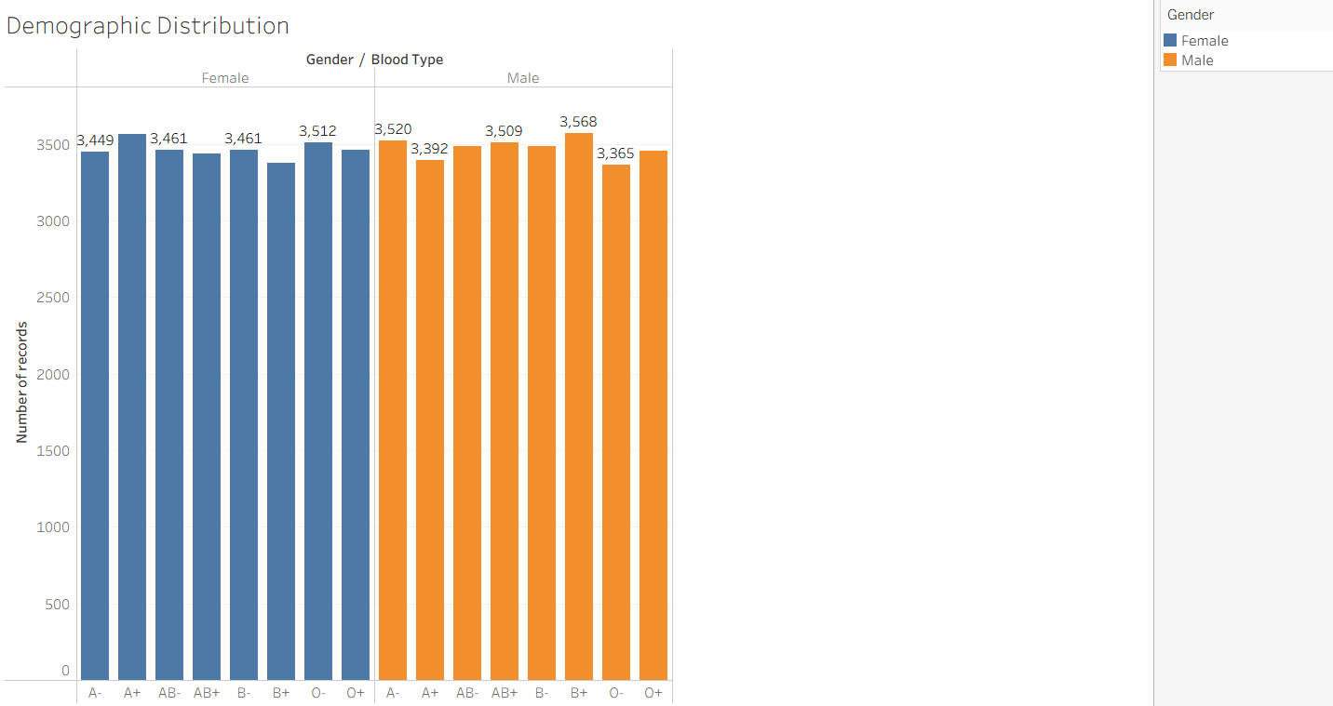

Demographic Distribution (Gender & Blood Type)
Key Insights:
The dataset is well balanced across gender and blood type, reducing risk of bias in further analysis.
This demographic spread helps ensure that any findings (e.g., condition prevalence, test result outcomes) can be compared fairly across groups.
Healthcare professionals can use this baseline to design interventions without overrepresenting or underrepresenting any blood group.

Slide 4
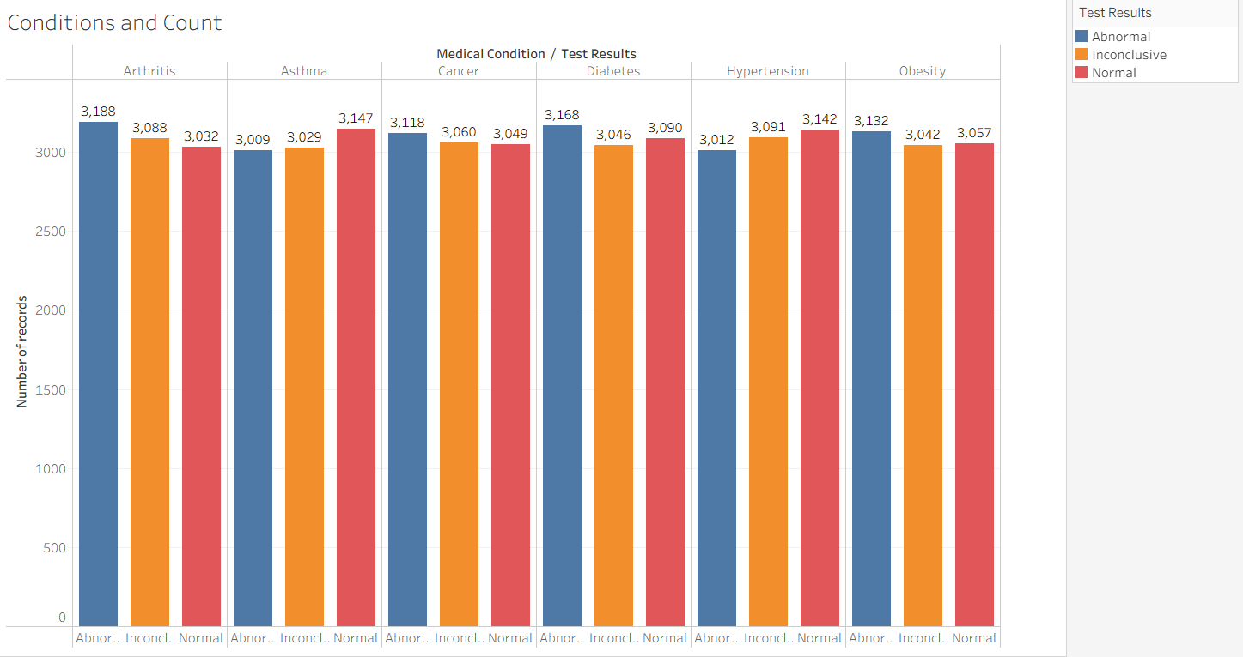
Medical Conditions and Test Result Distribution
Key Observations:
Arthritis & Cancer → Slightly higher share of abnormal results compared to normal.
Asthma → Noticeable increase in normal results (3,147) compared to abnormal and inconclusive.
Diabetes & Hypertension → Balanced distribution across the three test outcomes, but normal results edge slightly higher.
Obesity → Shows relatively even spread, with abnormal cases (3,132) slightly higher than normal (3,057).

Slide 5
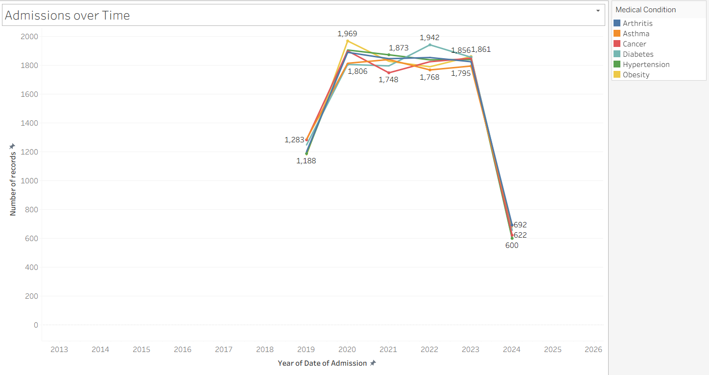
Admissions Over Time by Condition
Key Observations:
2020 Peak: Suggests a surge in admissions, possibly linked to wider healthcare events (pandemic or data expansion).
2021–2023 Stability: Admissions maintained high levels, showing consistent patient inflows.
2024 Drop: Significant reduction across all conditions, indicating either improved preventive care, reduced reporting, or external disruptions.

Slide 6
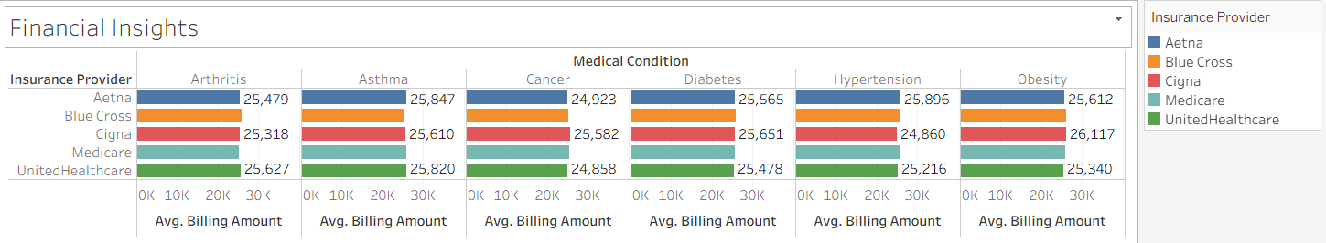
Financial Insights: Billing by Insurance Provider
Key Observations:
Highest Billing:
Obesity → Cross ($26,117) recorded the highest average billing.
Hypertension → Aetna ($25,896) also relatively higher.
Lowest Billing:
Cancer → UnitedHealthcare ($24,858) and Aetna ($24,923) reported the lowest average amounts.
Consistency:
Cigna consistently appears at the upper end of billing across multiple conditions.
Medicare and UnitedHealthcare remain moderately priced, with small variation between conditions.

Slide 7
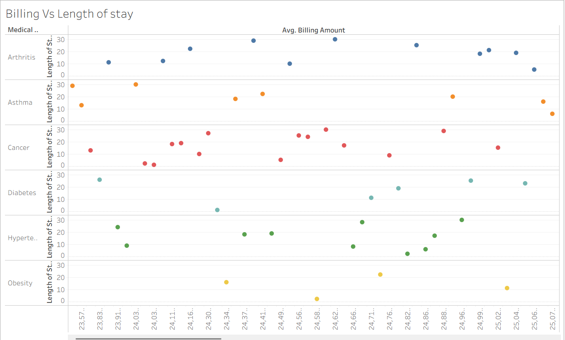
Billing vs. Length of Stay
Key Observations:
Arthritis → Longer hospital stays (15–30 days) are linked to higher billing amounts, with costs rising steadily.
Asthma → Generally shorter stays (under 15 days) with moderate billing amounts, showing lower financial burden.
Cancer → Mixed pattern; some cases have short stays but high billing due to costly treatments, while longer stays also drive up expenses.
Diabetes & Hypertension → Spread across short to medium stays (5–20 days), with billing relatively moderate and clustered.
Obesity → Fewer data points, but stays vary between short and long durations, with billing amounts sitting near the mid-range.

Slide 8
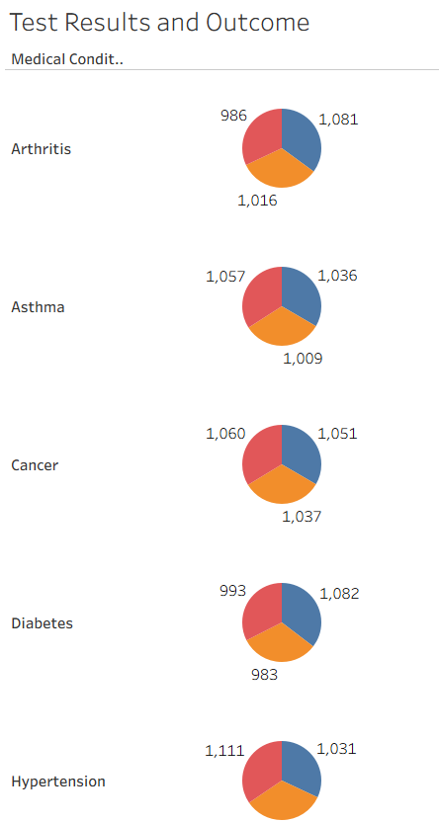
Test Results and Outcomes by Condition
Key Observations:
Arthritis → Outcomes are evenly distributed: ~1,081 abnormal, 1,016 inconclusive, 986 normal.
Asthma → Similar balance, with normal results (1,057) slightly higher than abnormal (1,036).
Cancer → Almost identical distribution across all three categories (~1,050 each).
Diabetes → Slightly higher abnormal results (1,082), with fewer normal and inconclusive (~983–993).
Hypertension → Shows a tilt towards normal (1,111), slightly higher than abnormal (1,031).

Slide 9
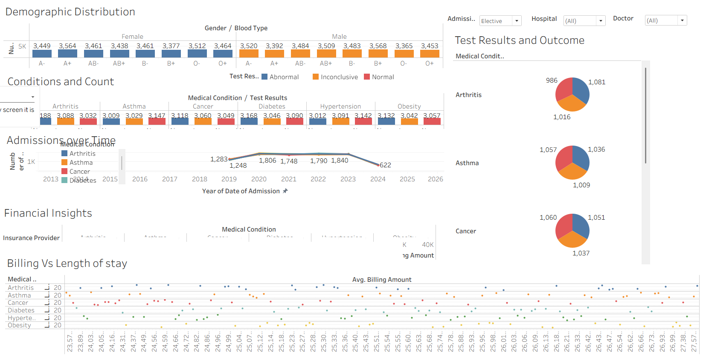
Demographic Distribution (Gender & Blood Type)

Slide 10

Conclusion
Recommendations
Tableau enabled a clear summary of patient demographics, medical outcomes, and financial insights.
Balanced data ensures reliable insights for decision-making.
Enhance diabetes care programs.
Review 2024 admission decline.
Optimize costs for obesity & hypertension treatments.
Analysis provides a foundation for predictive and diagnostic analytics.

Slide 11

PART - 2
DIAGNOSTIC ANALYSIS OF SALES DECLINE

Slide 12
Introduction
Objective
To apply descriptive and diagnostic analysis using Tableau
Summarize health and sales data to identify trends and root causes
Demonstrate ability to communicate insights visually
Goal
Conduct Descriptive Analysis: summarize patient health metrics and trends
Conduct Diagnostic Analysis: investigate sales decline causes in retail dataset
Provide insights and recommendations for decision-making
Dataset
Patient Health Dataset: heart rate, blood pressure, cholesterol levels (time-based)
Retail Sales Dataset: sales transactions by year, quarter, region, product category, and order value
Cleaned, structured, and visualized in Tableau dashboards

Slide 13
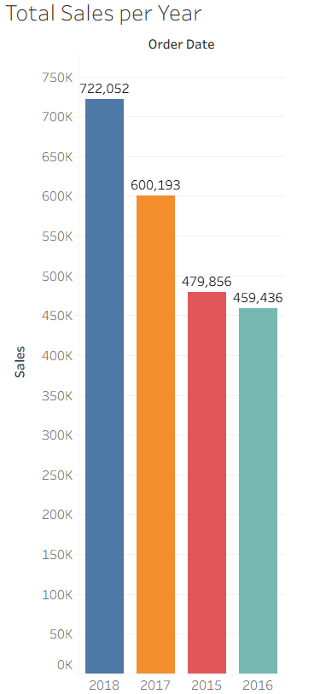
Total Sales per Year
Sales peaked in 2018 (722,052)
2017 (600,193) also showed strong performance
2015 (479,856) and 2016 (459,436) were comparatively lower
Indicates an overall upward trend until 2018, followed by recent decline (as seen in quarterly analysis)
Confirms that the sales issue is recent, not a long-term weakness

Slide 14

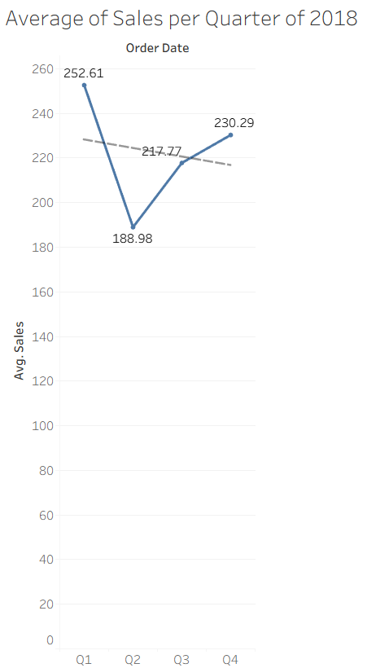
Average Sales
per Quarter of 2018
Q1 had the highest average sales (252.61)
Sharp drop in Q2 to 188.98
Recovery in Q3 (217.77) and Q4 (230.29), but still below Q1 peak
Overall downward trend line confirms weaker performance later in the year
Suggests issues arose mid-year, requiring further breakdown by products, regions, or customer segments

Slide 15
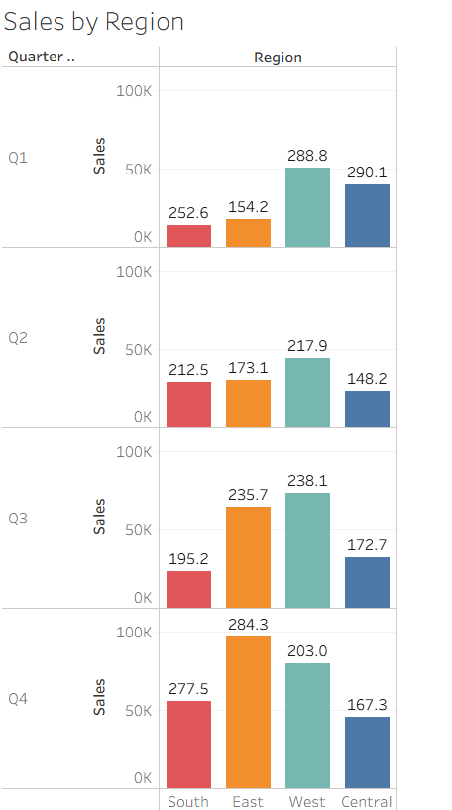
Sales by Region
Q1: West (288.8) and Central (290.1) led sales, South (252.6) moderate, East lowest (154.2)
Q2: Significant declines across all regions, especially Central (148.2) and South (212.5)
Q3: Recovery in East (235.7) & West (238.1), but South (195.2) and Central (172.7) stayed weak
Q4: Strong comeback in South (277.5) and East (284.3), while West (203.0) and Central (167.3) lagged
Insight: Sales decline concentrated in Central and South regions; East emerged as a recovery driver in Q3–Q4

Slide 16
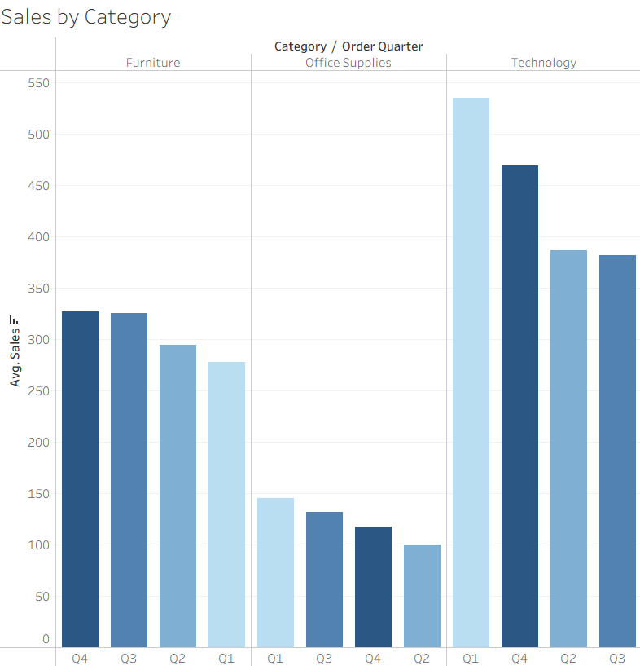
Sales by Category
Furniture: Sales peaked in Q3 & Q4, but steady decline from earlier quarters (Q1–Q2 lower)
Office Supplies: Consistently lowest-performing category; no significant recovery across quarters
Technology: Strongest category overall (Q1 ~540, Q4 ~470), but shows clear decline after Q1
Insight:
Sales decline largely driven by Technology drop after Q1
Furniture stable but moderate performance
Office Supplies weak → contributes less to total sales growth

Slide 17
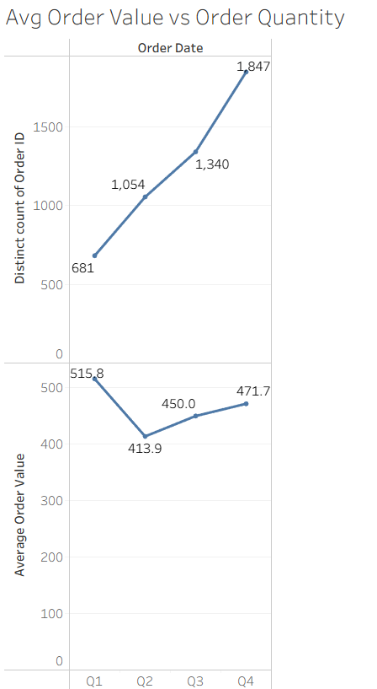
Avg Order Value vs
Order Quantity
Order Quantity: steady growth across quarters (Q1: 681 → Q4: 1,847 orders)
Average Order Value: highest in Q1 (515.8), drops in Q2 (413.9), partial recovery by Q4 (471.7)Key
Insight:
Customers placed more orders over time but spent less per order
Sales decline tied to a shift from fewer, high-value orders to more frequent, lower-value orders
Suggests issues in pricing strategy, discounts, or customer purchasing power

Slide 18
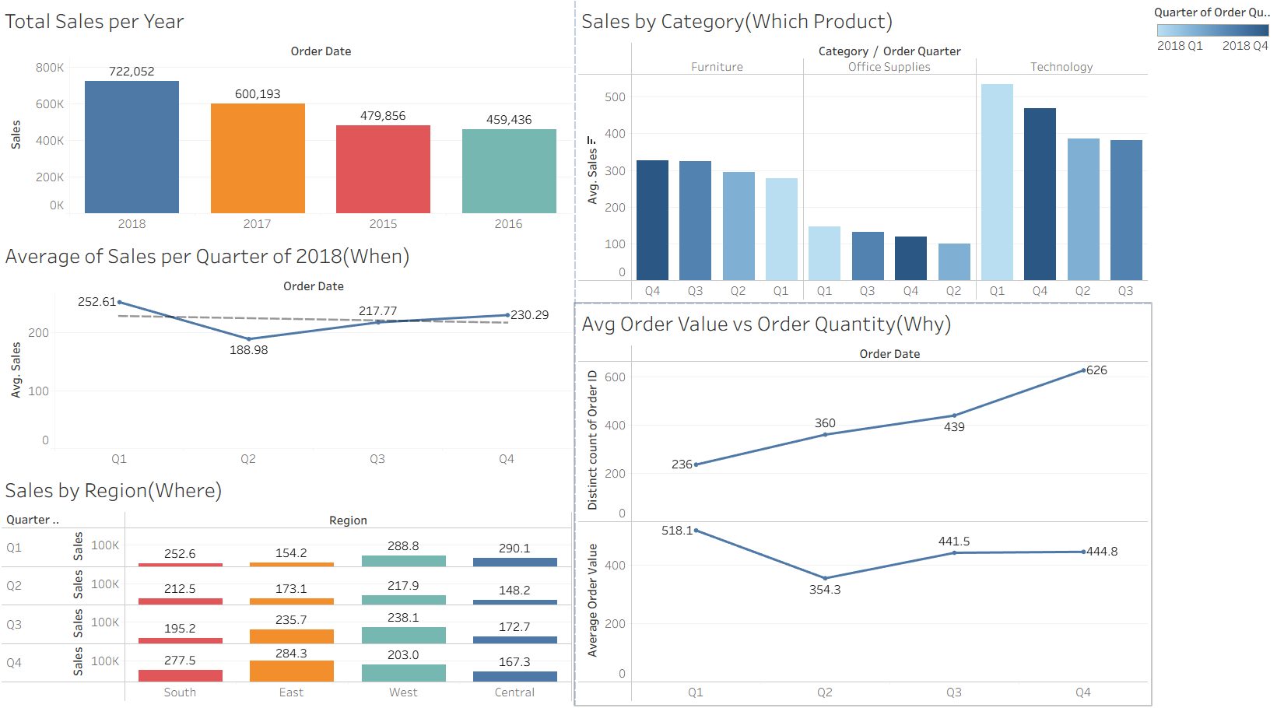
Dashboard

Slide 19
Recommendations
Q2 shows the biggest dip management should investigate seasonal factors, competitor actions, or promotions missing in that period.
Relaunch marketing campaigns or discounts for high-value Technical Products
⁠Provide region-specific promotions, better inventory availability, and focused sales training.
⁠Introduce bundles, upselling, and cross-selling to encourage larger baskets.

Slide 20


Thank
You

